Slide 1
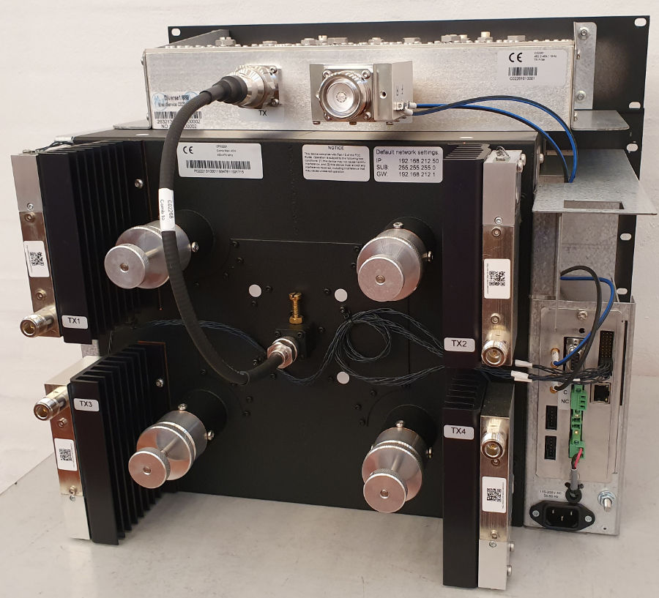
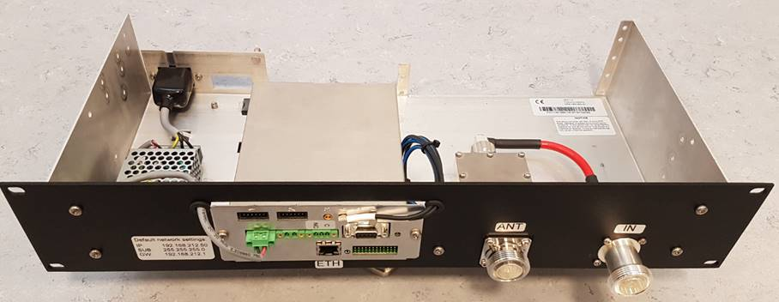
Tx Antenna Power Monitor
  Needs: Increase system uptime, customer satisfaction and revenue. Decrease maintenance costs.
  Solution: Frequency selective or composite Tx antenna power monitor
  How it Works
    Integrated in the combiner, Tx filter and duplexer, and stand-alone model
    Frequency selective PM: 7/800, 900, and UHF combiners, as well as UHF filters
    Composite PM in 7/800 Tx filters
    Locally fine-tune the combiner while system is live – no need to switch off other channels
    Remote, continuous monitoring = identify issues before they become big problems: Forward power | Antenna return loss | Temperature (equipment and shelter) | Door alarms
    Software configurable (e.g., special requests) | Stand-alone “power meter” | Web server, SNMP and SYSLOG | UEM integration expected soon
    Video: https://www.youtube.com/watch?v=CDHGWHCRhD0
Combiner with post Tx-filter filter and
Power Monitor
Stand-alone Power Monitor
Notes:
For more detail, see “Notes on Combilent Tx Antenna Power Monitor.”

Slide 2
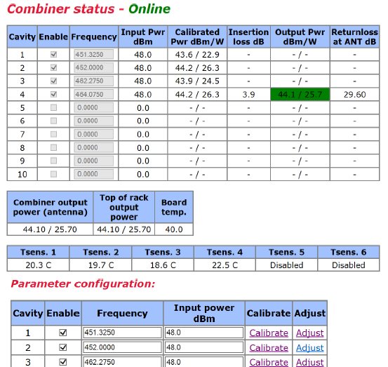
Tx Power Monitor

Slide 3
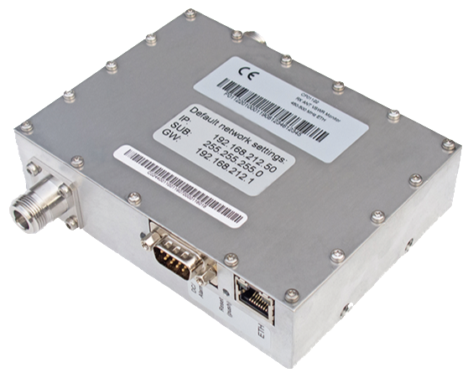
Rx Antenna Monitor
Needs & Challenges
  Increase system uptime, customer satisfaction and revenue. Decrease maintenance costs.
  Using test equipment for Rx antenna monitoring is not cost effective
  Continuous monitoring of the Rx antenna is as important as monitoring the Tx antenna to ensure system is operating efficiently
  Rx antenna also is susceptible to weather (e.g., water, ice, lightning)
Solution: Rx antenna monitor installed in-line with the Rx antenna
How it Works
  Measures return loss at a customer-specified frequency, board and room temp.
  Scans for high level carrier interference in 1 MHz steps. We are working on refining the step size.
  Compact unit (6” x 6” x 2” and 2 lbs.) simplifies the design and installation process and helps save rack space
  Integrated web server, SNMP, SYSLOG
  Alarms are user configured via Ethernet or SNMP
  VHF, UHF, 7/800 MHz and 900 MHz
  AC or DC power
  Video: https://www.youtube.com/watch?v=RqaNgGJ1myM
Notes:
Rx antenna monitoring is only available by using very expensive test equipment such as Site Master.

Slide 4
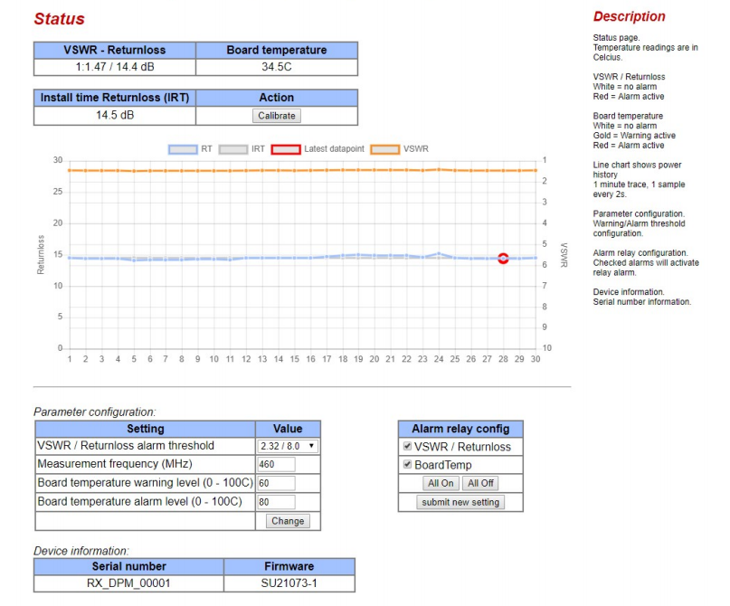
Rx Antenna Monitor

Slide 5
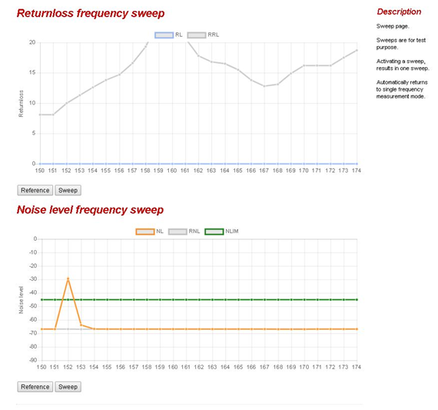
Rx Antenna Monitor

Slide 6
Business Case for Monitors
Increase customer satisfaction – Show customers the system is running optimally = increase customer satisfaction
Increase system uptime – Can react to degrading trends. Resolve potential problems quickly & before customer alerted. System uptime and customer satisfaction increase.
Increase maintenance revenue – With the additional value noted above, one may choose to increase monthly maintenance fee
Decrease the cost of PM and increase system uptime -- Before driving to the site to PM it, remotely check the Tx antenna, combiner, Rx antenna, cables and connectors to determine if the equipment are working well. If yes, eliminates need to:
  PM the equipment = time and money saved
  Take apart cables and connectors -- introduces more problems
  Shut down the system for PMing the equipment
Decrease truck rolls and labor costs – System to send warning alarms (yellow). Decide if it’s necessary to attend to an alarm now or wait to go to the site later (when something else is scheduled to be worked on). Combine site visits to decrease truck rolls and costs.

